Slide 1


Using Data to Drive Curriculum Development
Chester Ismay
Senior Curriculum Lead
2018-07-30
PDF of slides available at http://bit.ly/ismay-jsm
Notes:
Hello. Thanks so much for attending. It's my pleasure to be in this session with such great speakers and a special thanks to Albert for organizing this session as chair. Today I’m going to talk about how we use data at DataCamp to support our mission.

Slide 2
What is
?
Notes:
Started in 2014, DataCamp is a company with headquarters in New York City, London, and Leuven, Belgium. I work from Portland, Oregon like many other remote employees from around the world. We currently have around 80 employees.

Slide 3

DataCamp’s mission is to help individuals and companies at every step of their journey to become data fluent by building the smartest data science education platform out there.
Notes:
Our overarching goal is to improve data fluency and literacy throughout the world with a focus on learning by doing. We want our learners to receive informative feedback as immediate as possible to help them fix their mistakes and improve their data science skills.

Slide 4
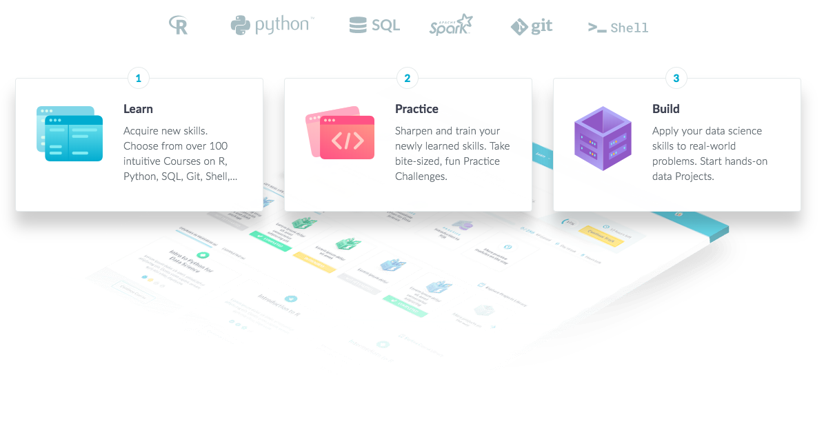
Notes:
Our learning philosophy is heavily influenced by both research on how people learn and a focus on creating a fun and engaging learning experience.
As a learner, you need to go through an iterative process consisting of 3 steps. 1. Learn. Start from zero and learn new techniques.
2. Practice. Get better at possibly forgetting and then remembering the content you learned.
3. Build. Apply your learned skills to new real-world problems to test for understanding.

Slide 5


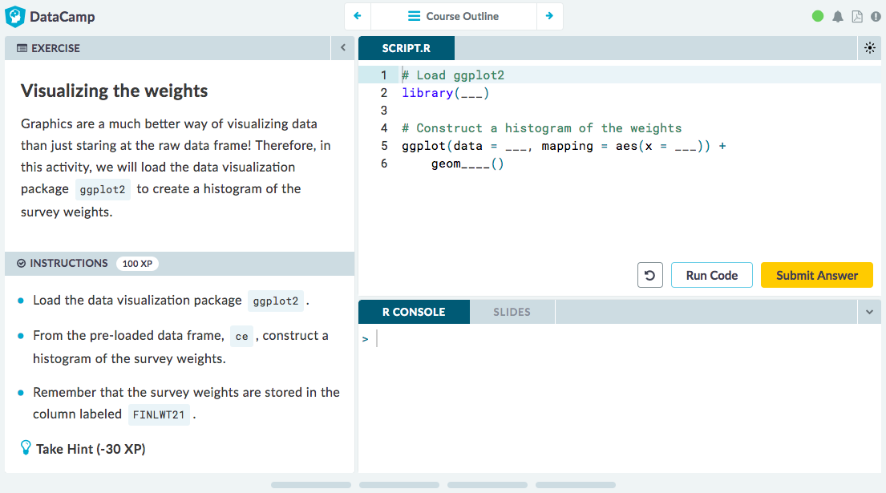
Learn | https://datacamp.com/courses
Notes:
Step 1: Learning takes place in an interactive environment that exposes a real R session to the student. This is a screenshot of an exercise from Kelly McConville’s Analyzing Survey Data in R course that was recently launched on DataCamp. It provides a great bridge course between statistics and data science!
In the top left, learners are given some context about the problem. They next can look over the instructions for the exercise. In the top right, some code is provided in this early exercise for the course. Students write their code right there in the browser and try it out. They can also review the slides from throughout the course corresponding to the presentations that instructors give to begin each lesson.

Slide 6

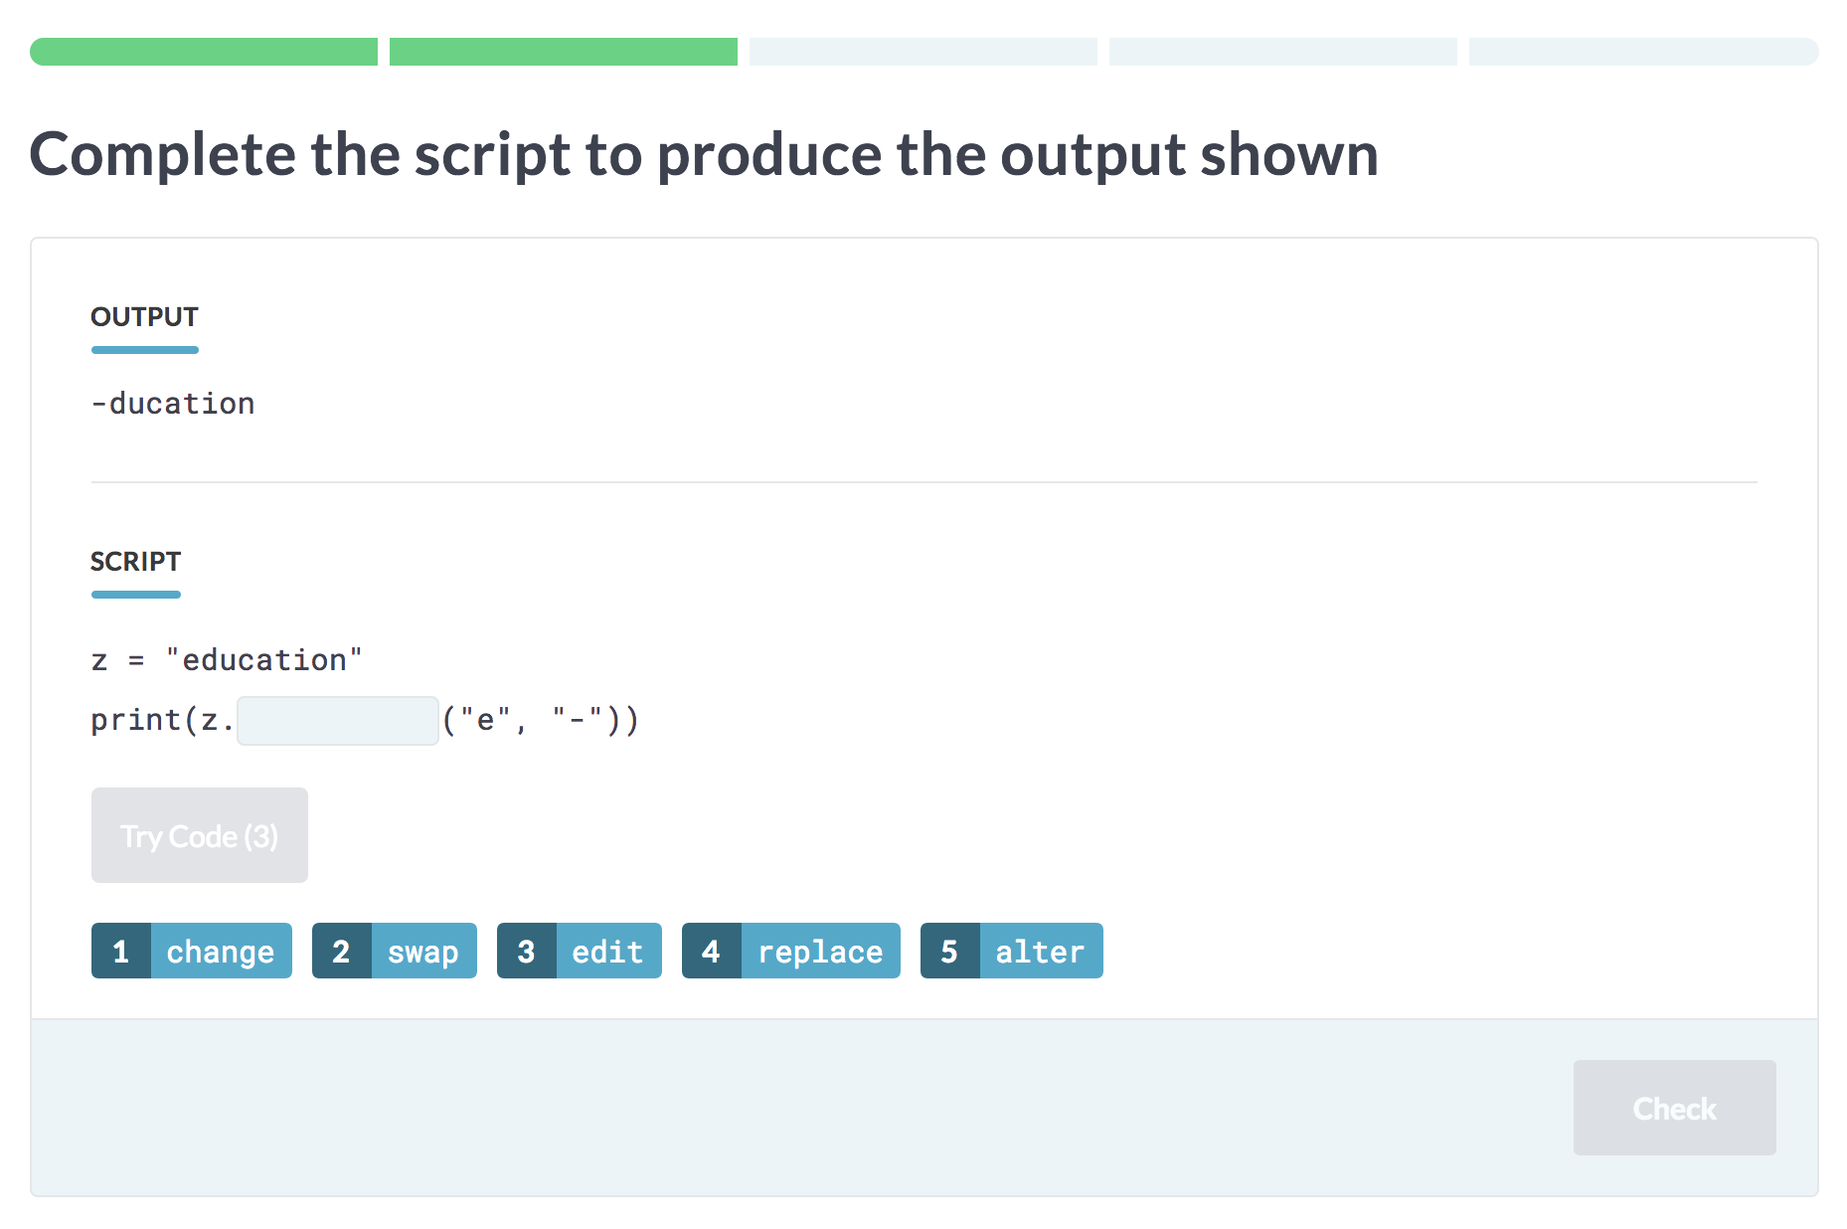
Practice
Notes:
Once you’ve learned a topic, you need to practice to gain fluency. Building fluency obviously is a key component to becoming proficient in data science. Simple sets of interactive challenges on multiple courses can be completed on the desktop or on mobile devices. We have a DataCamp app on both Android and iOS to let you practice data science on the go during your commute on the train or as you relax before bed at night.

Slide 7

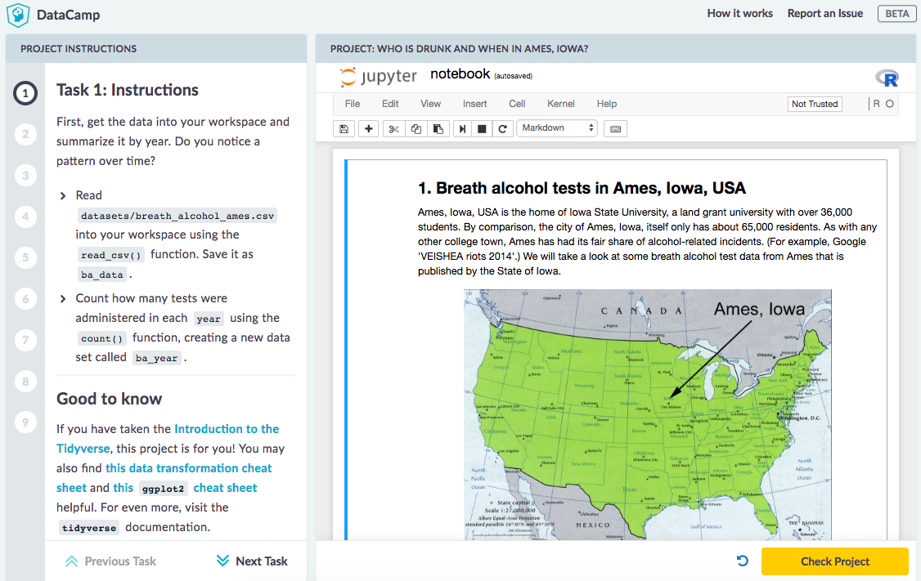
Build | http://datacamp.com/projects
Notes:
At the end of the day, employers want people to be able to apply that knowledge to real life data science problems. This is where projects come in.
Using a notebook style interface, learners are guided through a real-world data science problem. This is a fascinating project created by Sam Tyner designed for beginners to R with the tidyverse emphasized throughout.

Slide 8
Data-driven approach to teaching data science
How do we evaluate and improve our curriculum?
How do we decide what to teach next?
Notes:
Next, I'd like to talk about how we use data to help us teach data science.
I'll begin with discussing how we use learner feedback to make our content better.
I'll then discuss briefly how we use data to help us decide which topics to build content for next.

Slide 9
How can we evaluate an
online course?
Notes:
Many of you I suspect are in academia and are wondering just how we can assess the quality of our online courses.

Slide 10
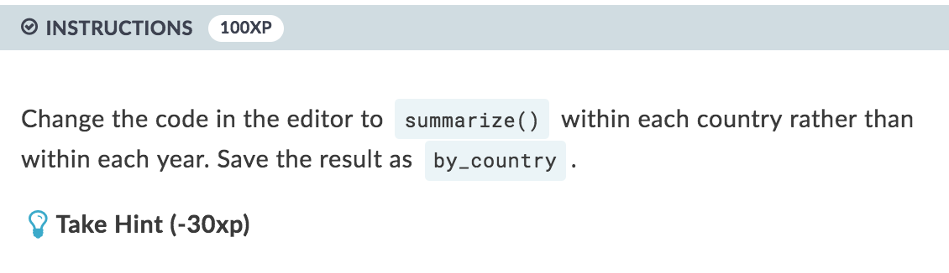
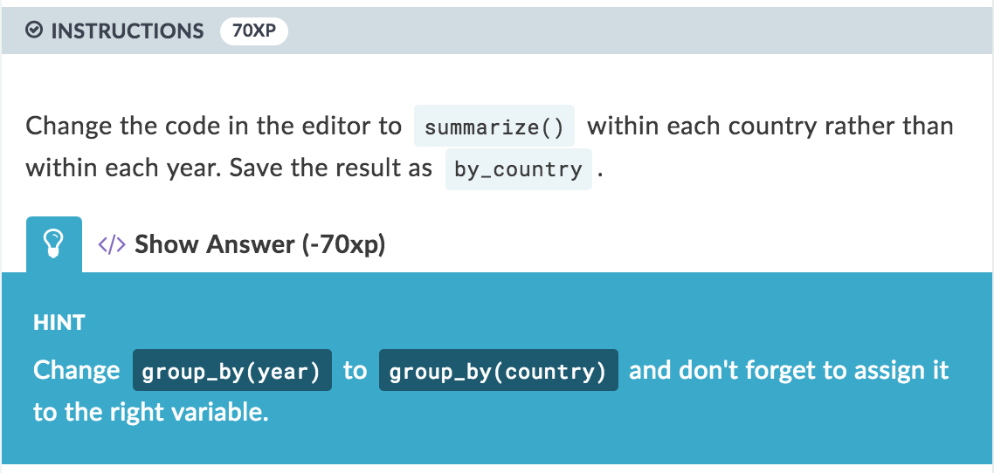

Exercise quality metrics
% asked hint
% asked solution
% reporting an issue
Notes:
We have three different main metrics to help us assess quality of exercises.
The first examines how frequently students ask for a clue on how to next proceed.
After students have asked for a hint and tried to update their code to get the correct answer, they can ask for the solution to the problem. We’d obviously like students to be doing more doing and less asking for answers so keeping this and the hint metric appropriately low helps us to make sure our content is challenging at the right level.
Our last main metric provides us with information on the number of issues our learners make for an exercise. One of the most common times this is done is if a learner believes that their code should work but is not being passed by our automated grading system. We can then review that submitted code and update as needed.

Slide 11

Hierarchy of content quality
Am I learning?
Is it fun?
Course rating
Is it doable?
% asking hint
Is it working?
% asking solution
% reporting an issue
Notes:
We have the following workflow in assessing content quality and we now have an entire team at DataCamp that works on this.
We begin at the lowest level of just making sure the exercise is working for the learner.
A high rate of asking for solution often corresponds to an exercise being too challenging or important information being missing.
The next level is similar in that it's checking to see how often is the description and instructions not enough.
We also look to see if students enjoy the course by analyzing the course's rating.
Ideally, we'd like a way to provide information to the learners on just how well they are learning the material.

Slide 12
Looking deeper into completion rate
Notes:
We can also dig a little deeper into the completion rate metric by analyzing the data from our databases. Dave Robinson created three courses for us while he was a data scientist at Stack Overflow. They are designed for beginners with Intro to Tidyverse, intermediate users with Foundations of Probability, and a little more advanced with the Exploratory Data Analysis case study course. As we can see here, more advanced courses have low completion rates where learners try to hop into them first.

Slide 13
Segmenting users by experience shows the true completion rates
Notes:
We can see that the trend continues through our 25 most started R courses with entry level courses being roughly the same in terms of completion rates throughout level of user experience and more advanced courses showing a much larger difference.

Slide 14
What can we tell about
the process of learning
data science?

Slide 15
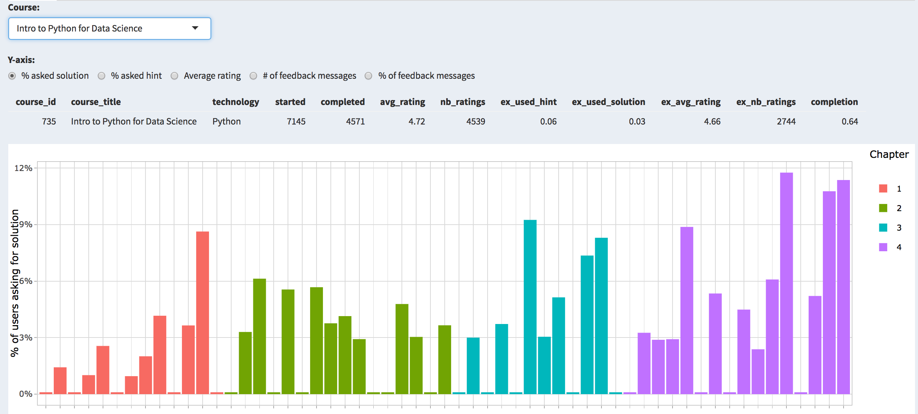
We understand what in a course is challenging
Notes:
We can determine where students are struggling and where exercises might be too easy. This is our internal content dashboard, which we use in examining the quality of a course and its exercises.
One bar represents one exercise in the course and on the vertical axis we plot the percentage of students requiring the solution.

Slide 16
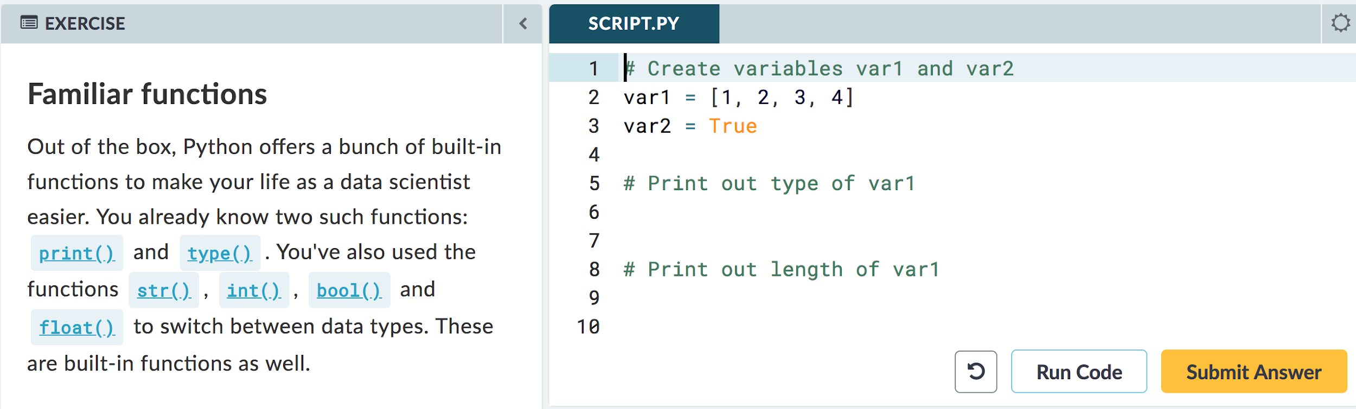
We understand what in a course is challenging
Notes:
Here’s an example of an easy interactive exercise where only a small percent of students ended up having to ask for the solution. Learners need only print out the type of a variable and its length.

Slide 17
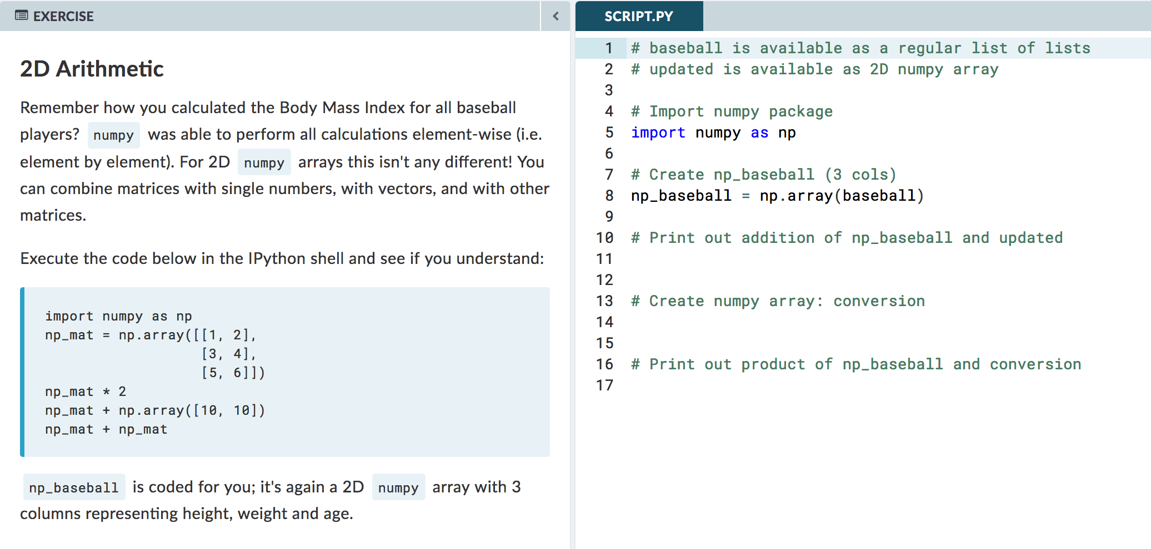
We understand what in a course is challenging
Notes:
The fourth chapter in the introductory Python course is about numpy, and it’s where the course gets a little harder, and more people need to ask for solutions. We can find the hardest exercise in the course: it’s this one that combines the ideas of two-dimensional arrays and element-wise operations.
This helps us understand at a high level what students struggle with. It’s important to note though that if exercises get too easy, people don’t learn or get demotivated -- finding that balance is key.

Slide 18
Deciding what to teach
Notes:
We are a data-driven company in many ways. We also use data to help us determine what content to build next.

Slide 19
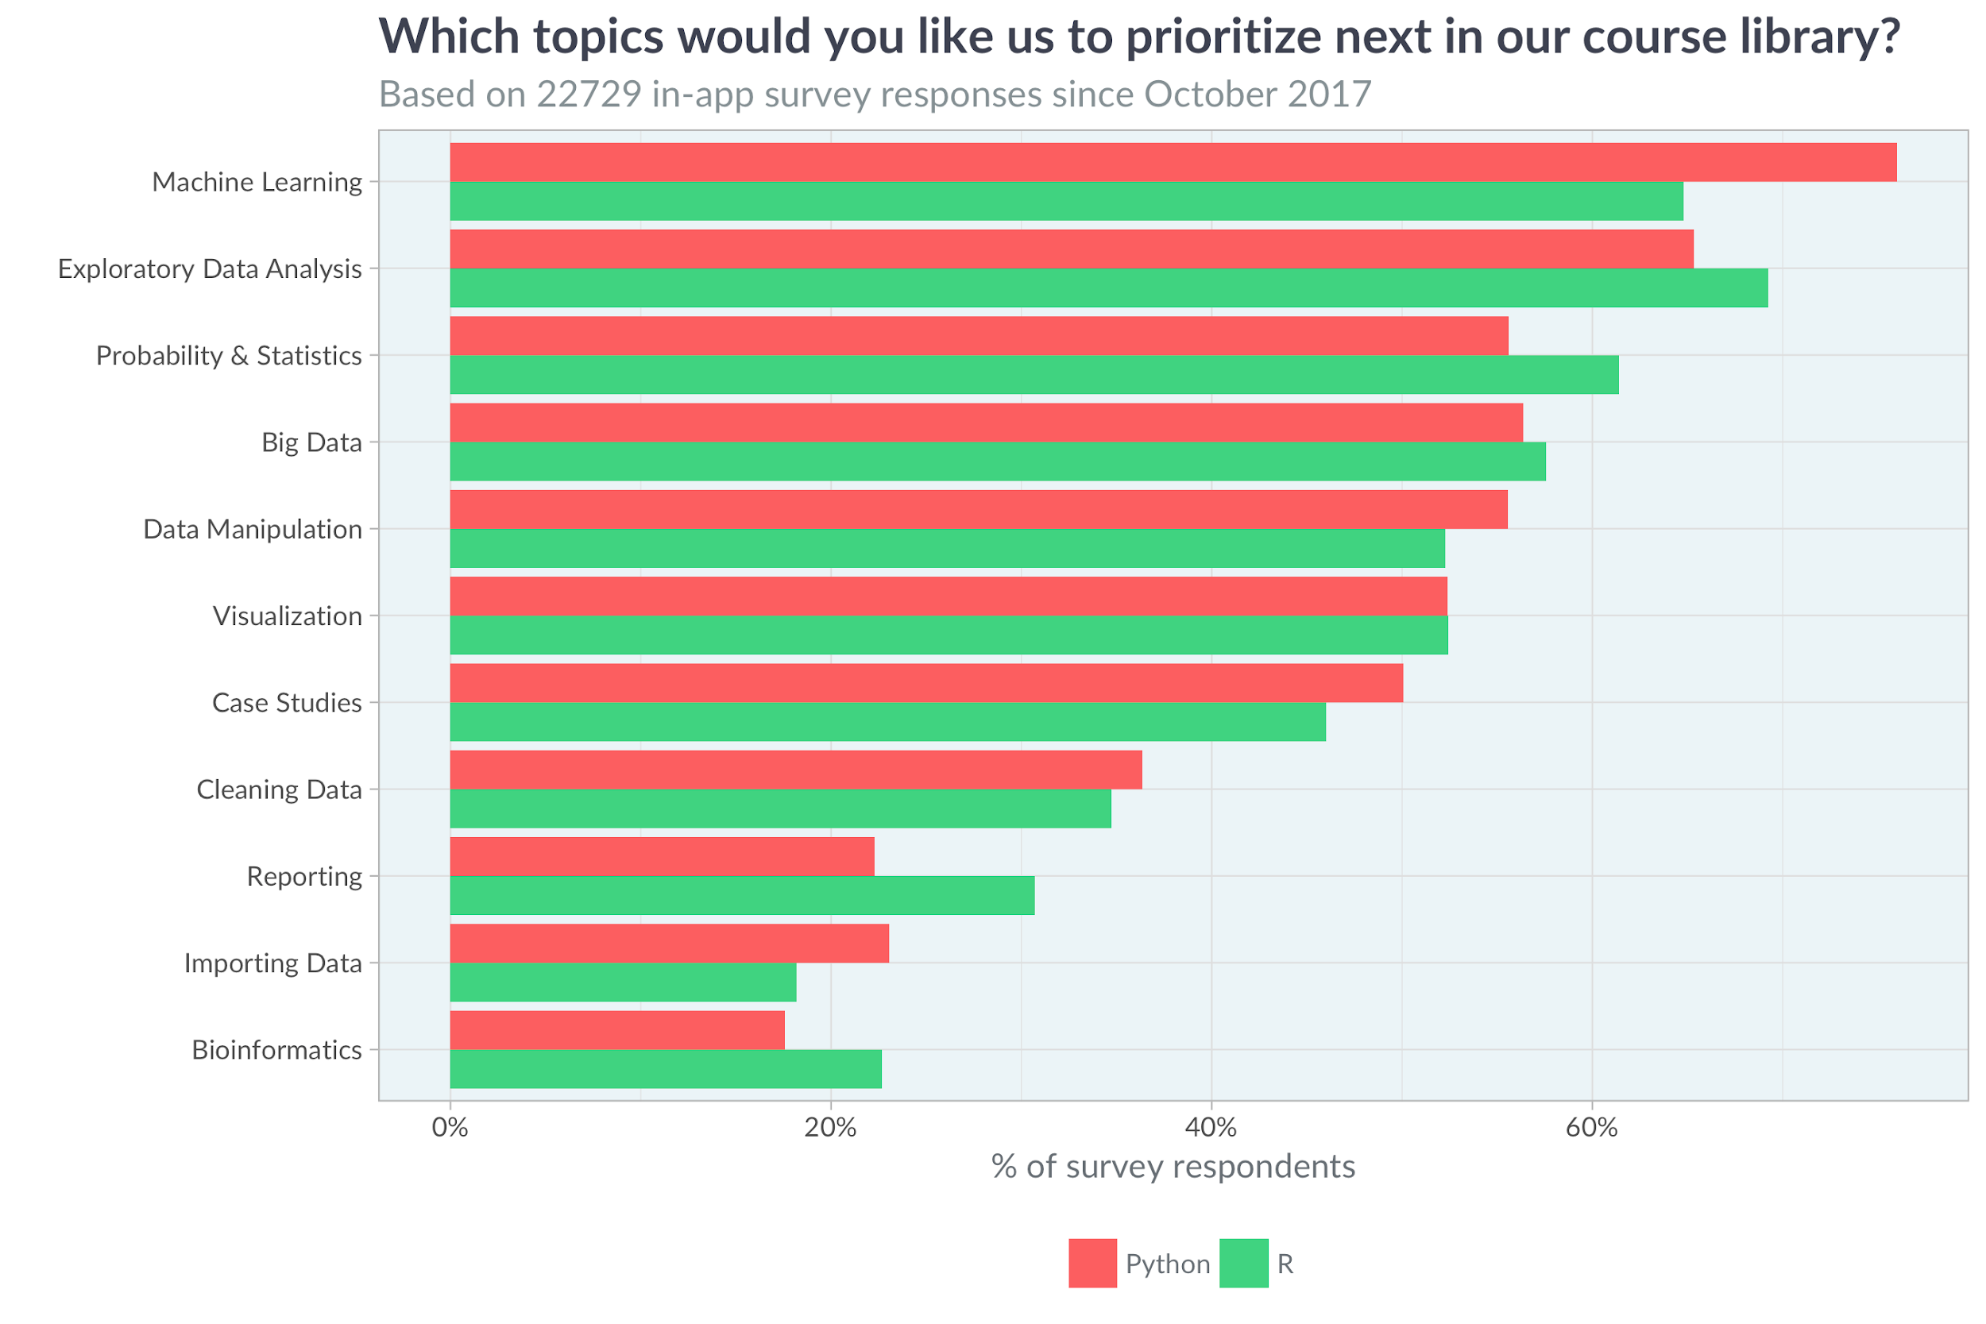
DataCamp users want new courses in machine learning and EDA
Notes:
We frequently ask our learners what areas we should build more courses on. Machine learning and EDA are almost always at the top for both R and Python.

Slide 20
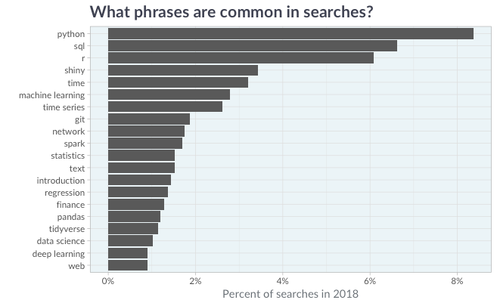
They search for time series, ML, networks, Spark, and text analysis
Notes:
We also analyze the results of the search box on DataCamp to assess what learners are looking for. Python is our top search term so far in 2018.

Slide 21
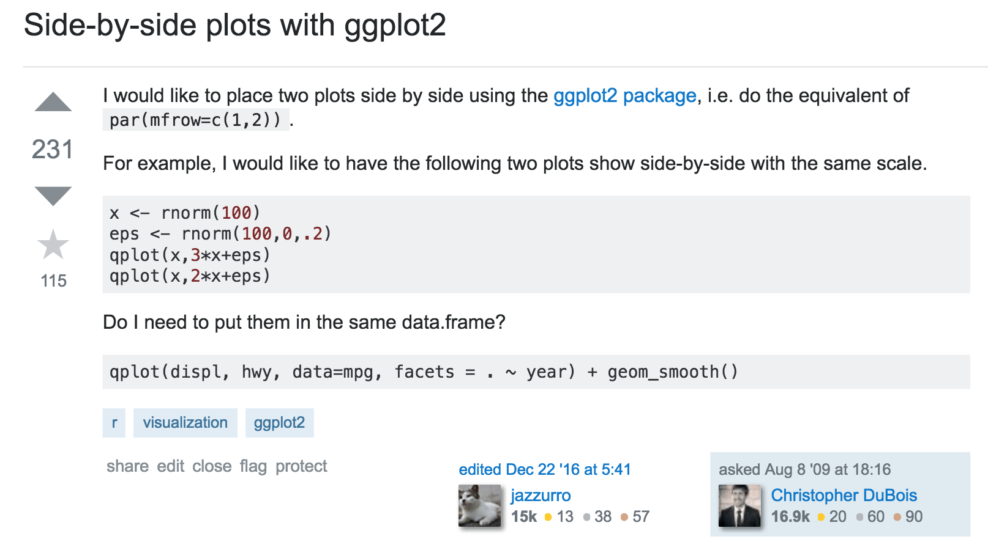

Understand where data science is going
Notes:
Lastly, my team and others at DataCamp also investigate trends in Stack Overflow questions and how things are trending on social media to better understand the demand of data science topics
such as visualization or ggplot2 as shown here in a Stack Overflow question.

Slide 22
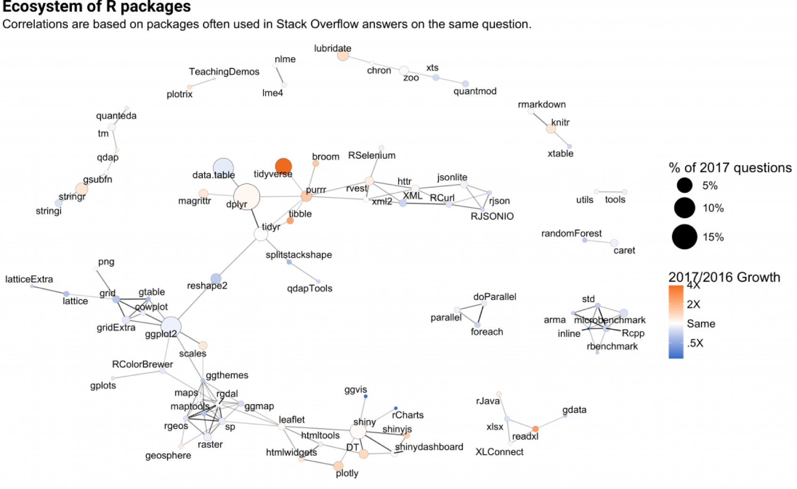

R package ecosystem: what is growing?
See The Impressive Growth of R
Notes:
Dave Robinson created this graphic showing the interconnectedness of R packages and growth of those packages.
Let's focus on this center portion of the graph for the moment which is focused on what?...

Slide 23
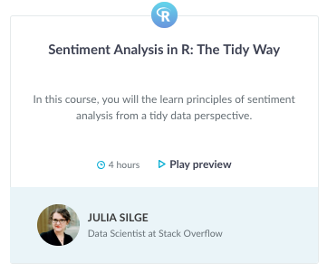
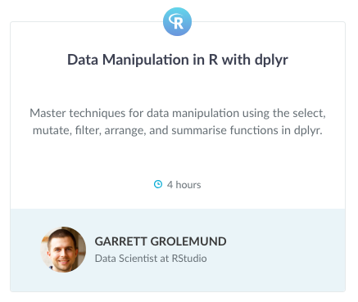
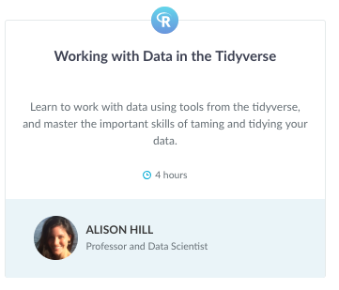
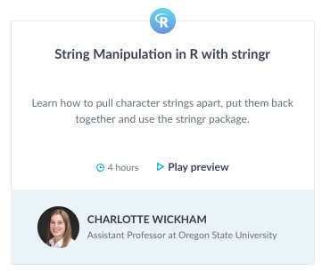
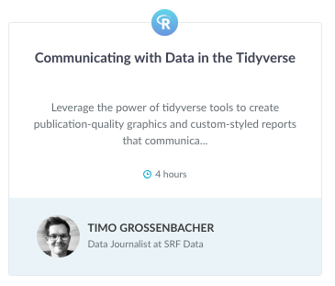
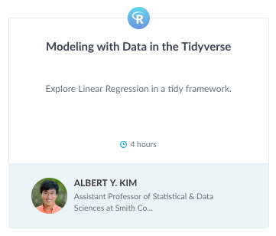
Development of a tidyverse curriculum
13 courses currently launched
With many more to come! Including…
Notes:
At DataCamp we currently have 13 tidyverse focused courses launched including these by Julia Silge, Garrett Grolemund, Charlotte Wickham, and this great course by data journalist Timo Grossenbacher from Switzerland.
We're also building many more including follow-up courses to Dave Robinson's Intro to Tidyverse course by Alison Hill and Albert Y Kim, which are set to be promoted and released soon.

Slide 24
If you’re interested in DataCamp...
Notes:
So maybe you'd like to know a little more?

Slide 25
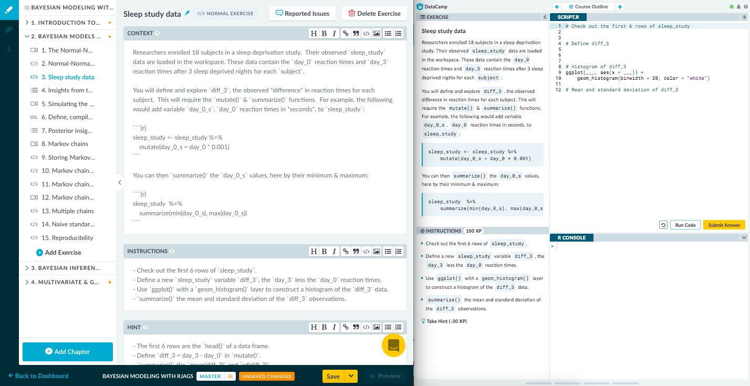
Teach | www.datacamp.com/create
Notes:
Our Teach platform is how courses, practice sessions, and projects are built. Shown here is an exercise from Alicia Johnson’s Bayesian Modeling course. The editor is on the left with an instant preview on the right. This isn’t just for our premium content instructors; anyone can use our teach application. In fact, it’s the way that I first heard about DataCamp back in 2017 when I was building my own free course for my Social Statistics students to use as homework and practice. Our enterprise clients have also used this tool to build additional training materials for their employees.

Slide 26
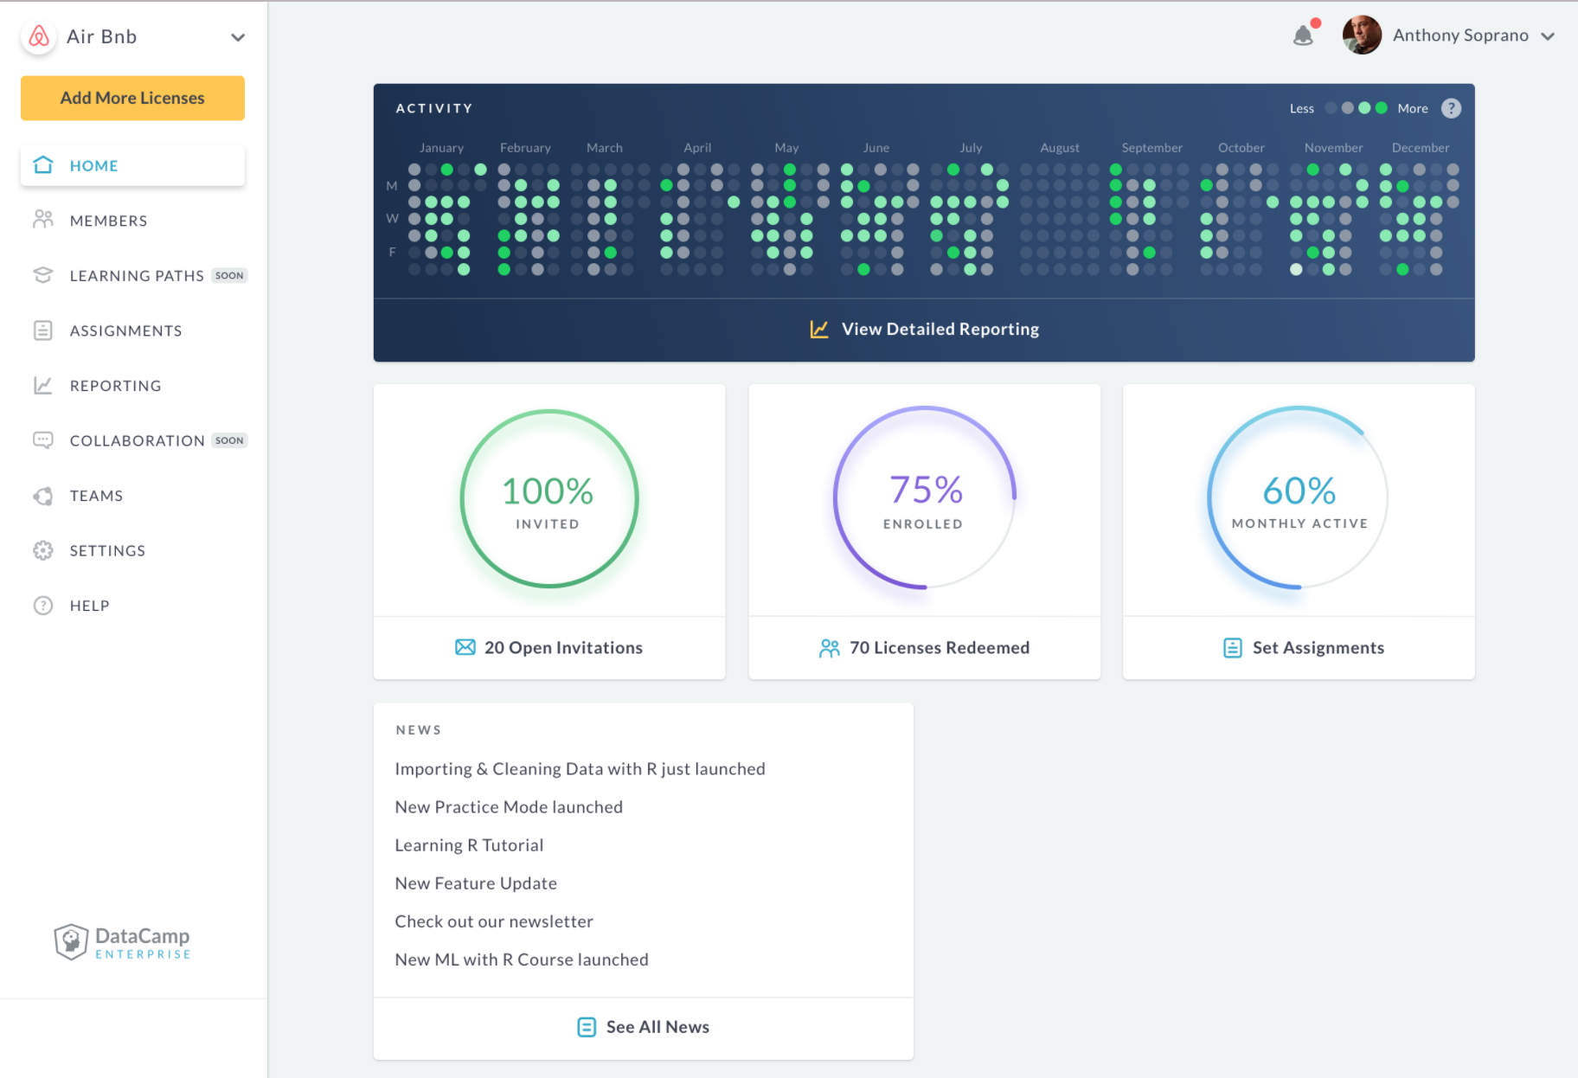
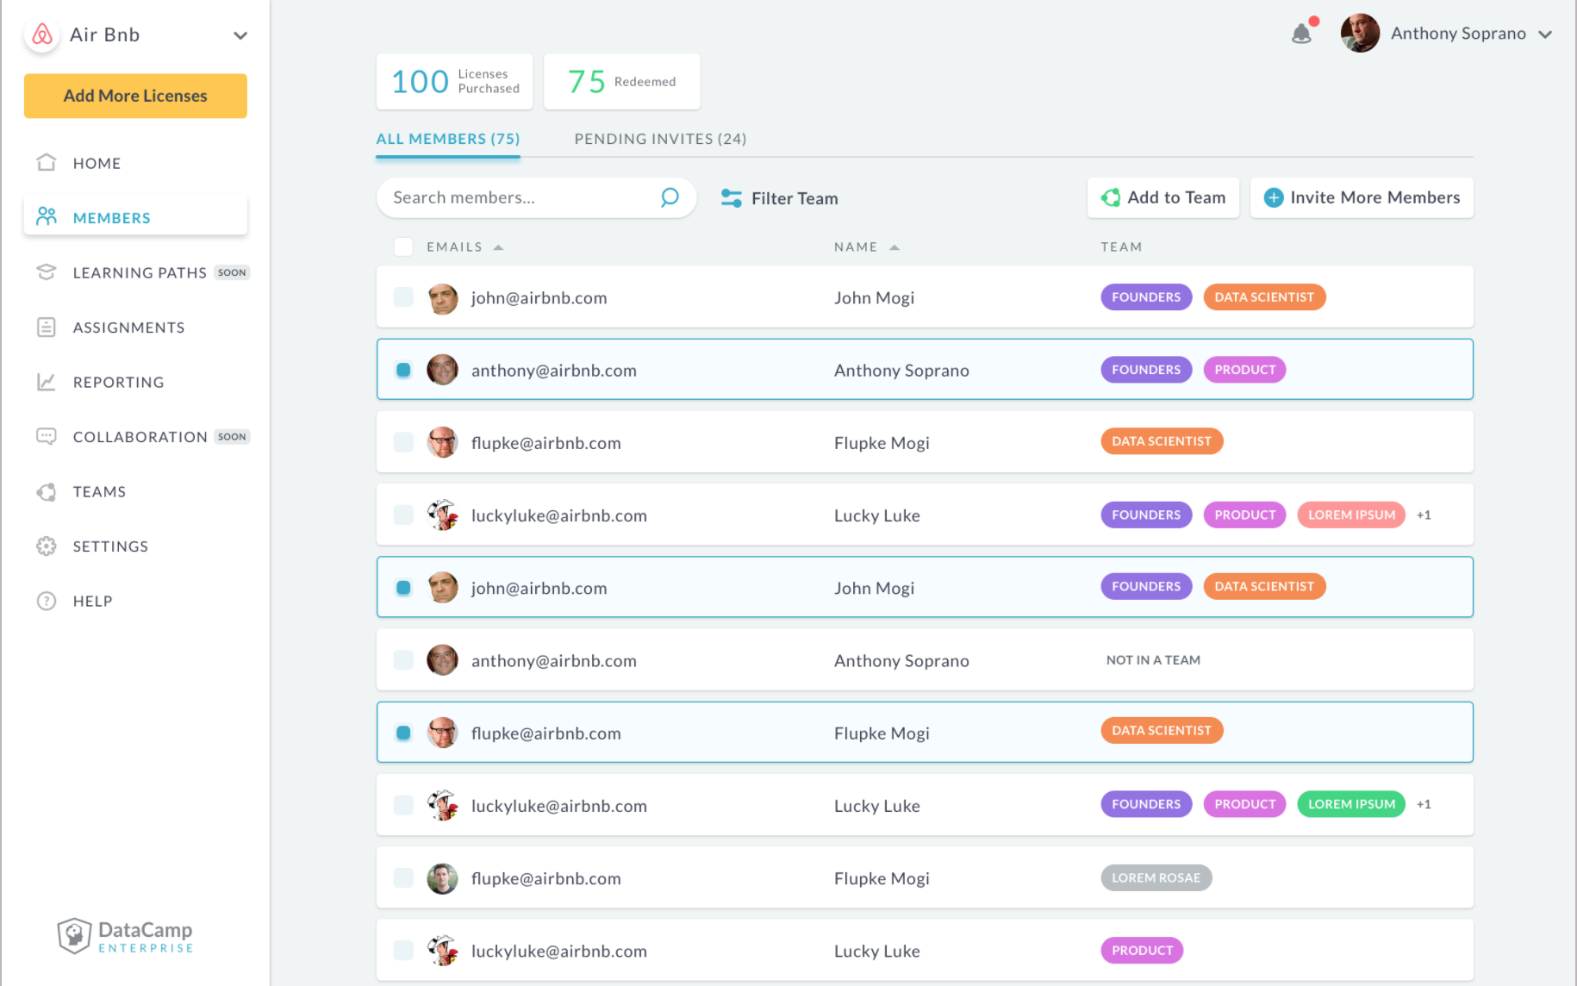
DataCamp for Business | www.datacamp.com/groups/business
Notes:
That’s a great segue into DataCamp for business, which helps OVER 600 businesses to improve and organize learning for small and large teams. We make it easy to create assignments for subgroups and for individuals and also monitor activity. It helps our clients understand who’s learning what and how well people are performing on the courses, practice sessions, and projects.

Slide 27
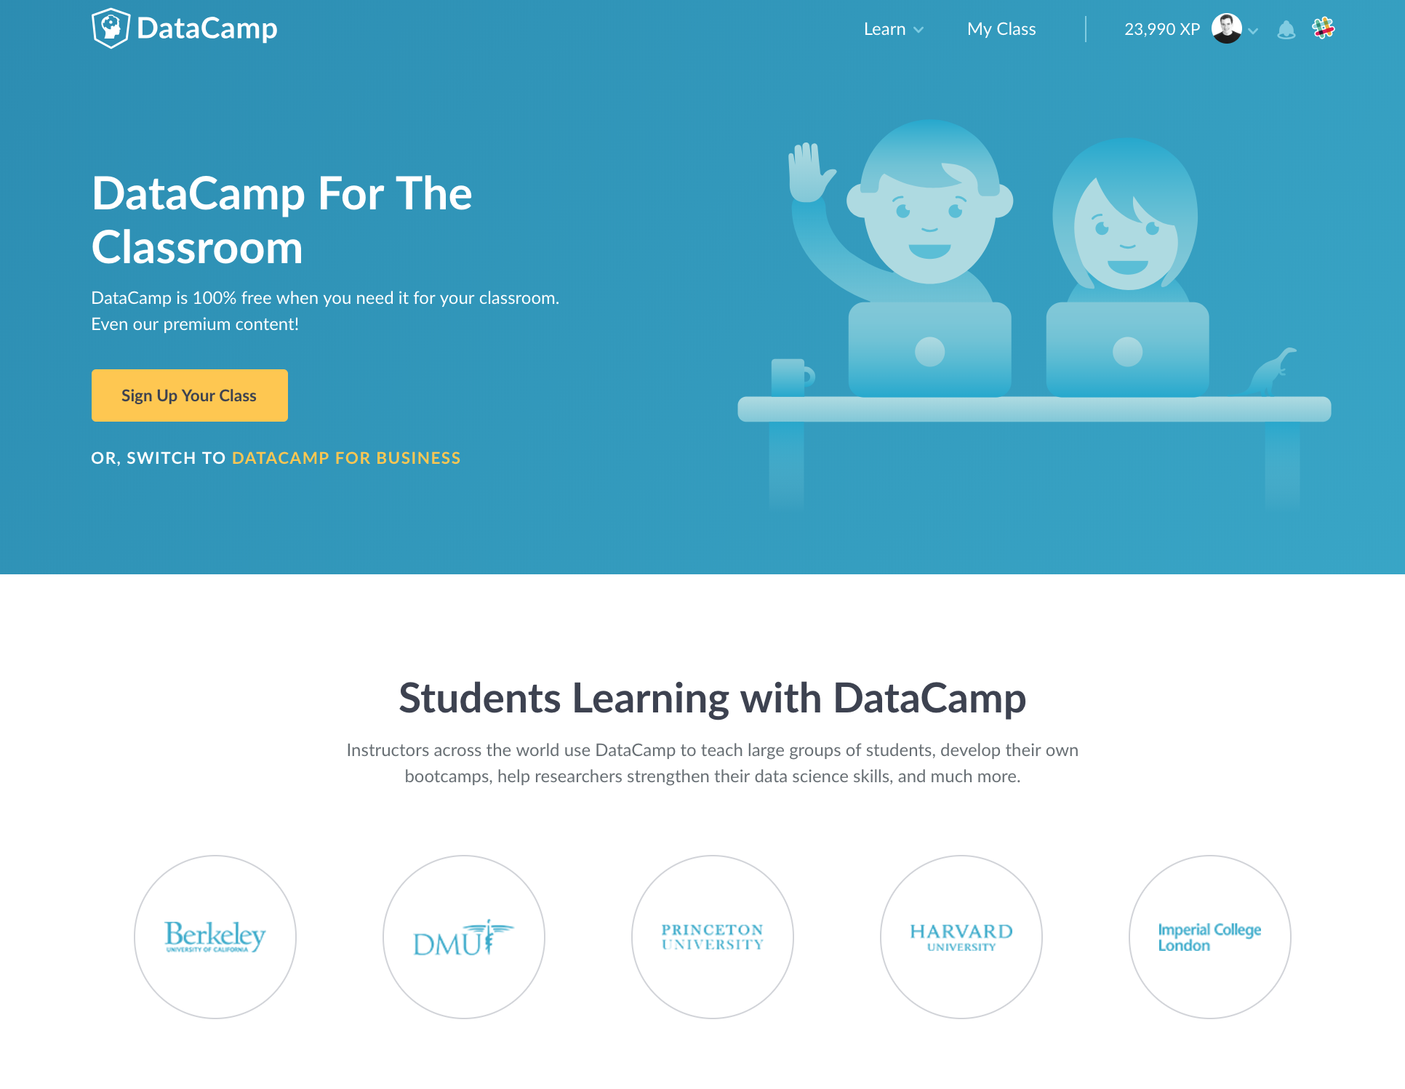
DataCamp for the Classroom | www.datacamp.com/groups/education
Notes:
This is also used by over 1,500 professors who take advantage of DataCamp in the classroom. We offer the platform including all of our premium content for free to them and their students.

Slide 28
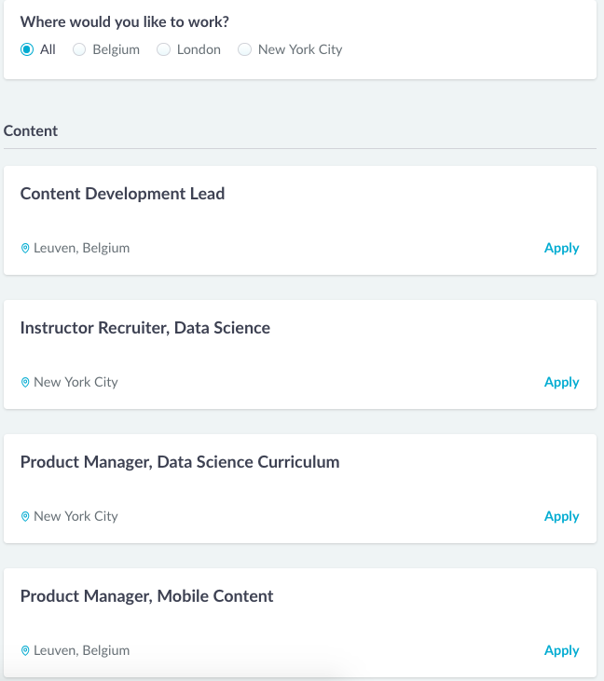
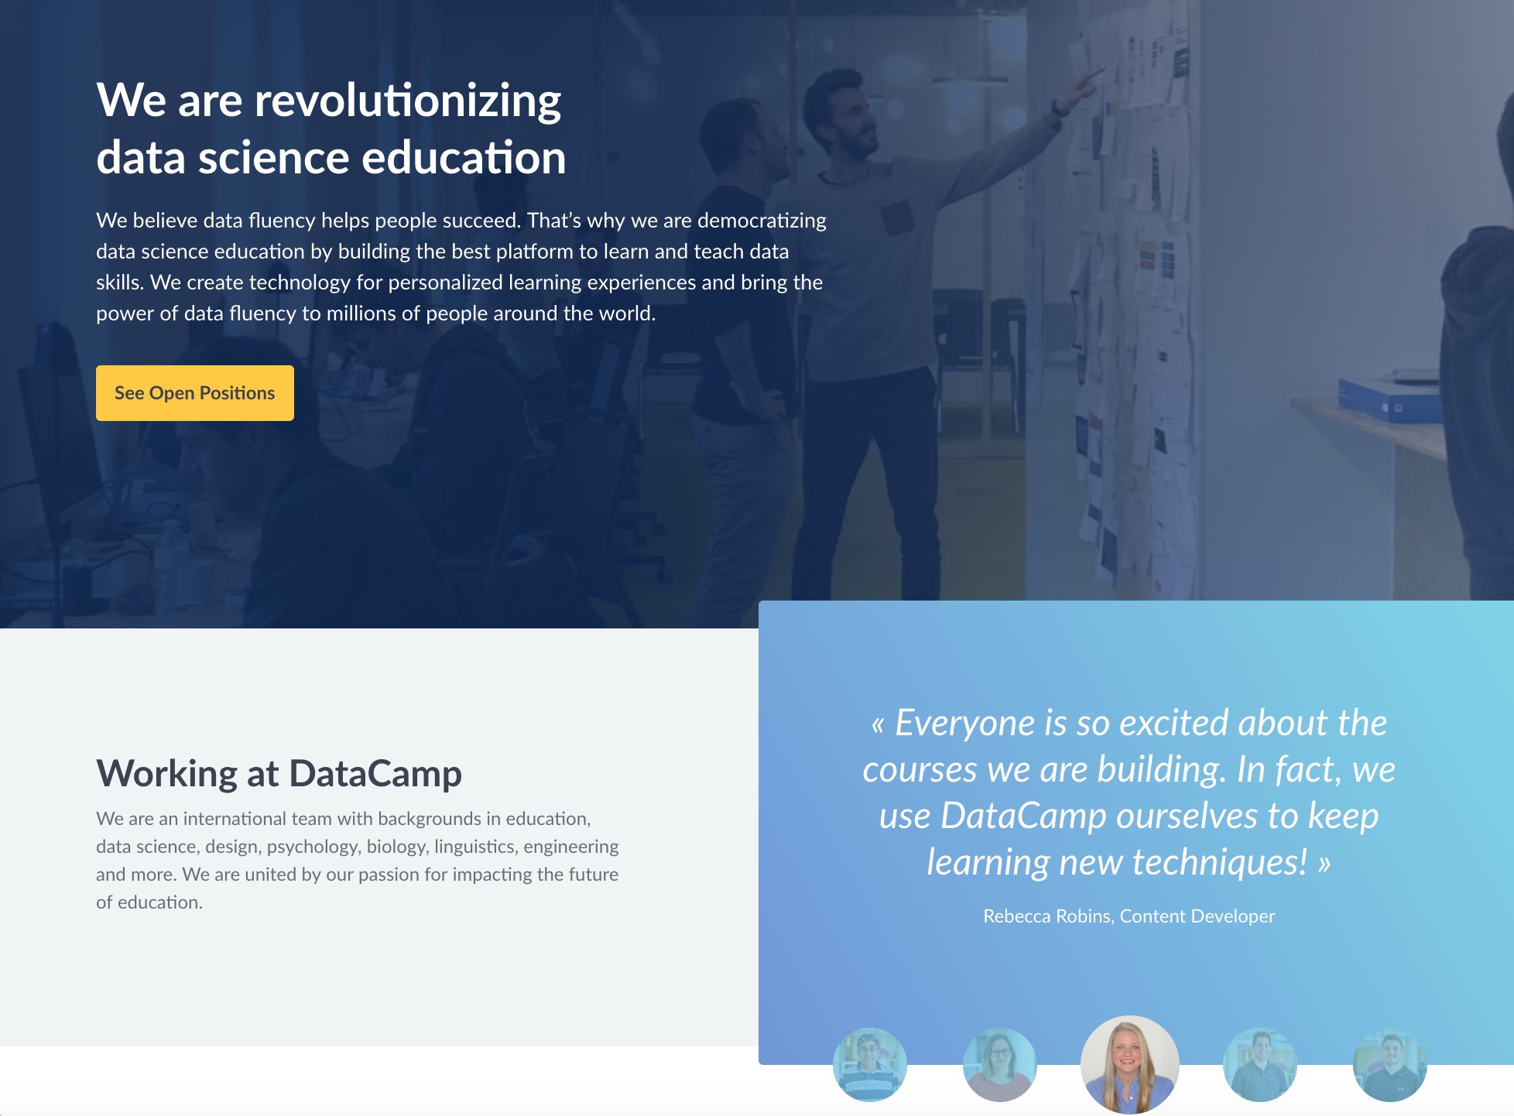
Come work with us | www.datacamp.com/careers
Notes:
As a company, we are looking to expand to over 100 employees by the end of the year and are always looking for instructors to help us build data science content as independent contractors.

Slide 29




Thank you
@old_man_chester
@ismayc
chester@datacamp.com
Special thanks to Dave Robinson
PDF of slides available at
http://bit.ly/ismay-jsm
Notes:
Please reach out to me here at the conference or online if you have any questions or if you’d like to chat about data science. Thanks much for your attention!

